Slide 1





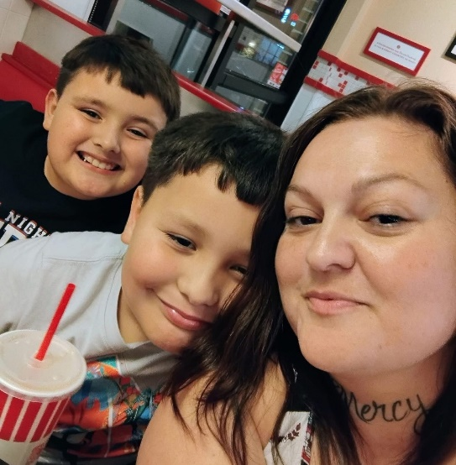






























THANK YOU TO OUR 2025 SPONSORS
TITLE SPONSOR
Presents the:
21st Annual
CASA 5K Superhero Run/Walk When: April 18, 2026 Time: 8:00am Place: Heritage Park
GOLD SPONSORS
CASA of the Coastal Bend would like to announce the 21st Annual CASA Kids Superhero 5K Run/ Walk. We are asking the Superheroes of the Coastal Bend, like you, to show support for children in foster care by sponsoring this major fundraising event. The battle against child abuse can be long and hard, but with your support, we can ensure every child’s voice is heard.
Samuel, age 2, and Jordan, age 1, were removed from their mother in September 2018. Their mother was also pregnant with another child. Angela was in a dark and painful place—battling addiction, lost in isolation, and barely clinging to life. Multiple relapses had taken a devastating toll, leaving her consumed by hopelessness when her children were taken. But just when things seemed beyond repair, hope arrived. CASA Advocates Alicia and Thelma were appointed to speak up for Samuel and Jordan’s best interests. These advocates did more than fulfill a duty—they walked alongside the family. They encouraged Angela through her recovery, helped her navigate the court system, and, most importantly, believed in her when she couldn’t believe in herself.
SILVER SPONSORS
BRONZE SPONSORS
Pictured left to right Jordan, Samuel and Angela
“The CASA Volunteers watched me grow. They stood by us through every hard moment. They connected with my children, offering them love, hope, and consistency when everything else felt so uncertain.” - Angela (Mom)
Angela committed to her recovery and reclaimed her life, step by step. Today, she is six years sober. Her children—now 6, 9, and 10—are back home with her, thriving in school, and surrounded by love. Because of CASA, one family found their way back to each other and forward to a future filled with promise.
CASA volunteers bring children who are victims of abuse and neglect a strong voice and opportunity to thrive. 100% of the 5K proceeds ensure we strive to have a CASA for every child. Being a sponsor provides numerous benefits including reaching new target audiences, increasing stakeholder loyalty and making a social impact in the community where you do business. Please consider joining our 5K and help us give children a fighting chance.
Watch our 2minute video
With a thankful heart, Gregory Herrman Judge Timothy McCoy Herrman and Herrman County Court at Law #5 Title Sponsor
LAW OFFICES OF DAVID D. TOWLER

Slide 2
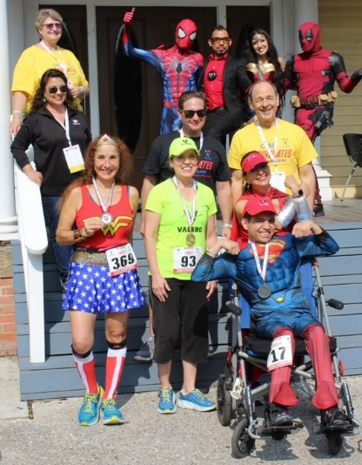


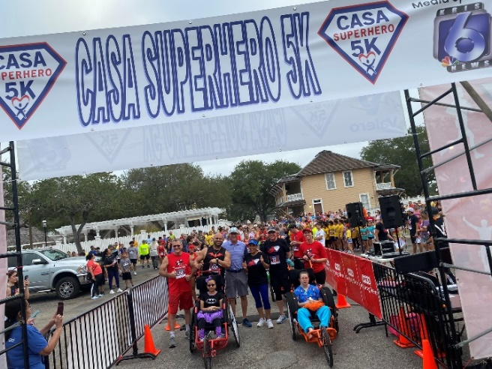
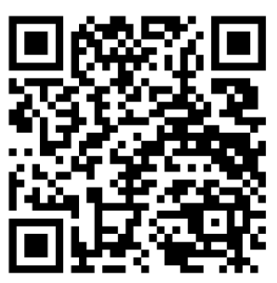
2026 SPONSORSHIP FORM
CASA Superhero
5K Run/Walk
When: April 18, 2026 Time: 8:00am Place: Heritage Park
Costume
Contest
All Sponsors Receive
Complimentary Race Entries with T-Shirts Logo on CASA Website and 5K Facebook Page
Shout Out Day of Race Opportunity to Place Promotional Items in Event Bags Booth Space at Event to Promote your Company
$5,000 Gold Sponsor
Large Logo on T-shirt Logo on 600 Race Bibs Logo on Registration Website Logo on TV PSA on KRIS 6 News Logo on Start/Finish Race Banner
Space for Banner at Starting Gate Logo place on 2026 Sponsorship Form as a Thank You
10 Complimentary Race Entries
$2,500 Silver Sponsor
Medium Logo on T-Shirts
8 Complimentary Race Entries
Logo on TV PSA on KRIS 6 News Logo place on 2026 Sponsorship Form as a Thank You
Media Sponsor
$1,000 Bronze Sponsor
Small Logo on T-shirt
5 Complimentary Race Entries Logo place on 2026 Sponsorship Form as a Thank you
$500 Copper Sponsor
2 Complimentary Race Entries
Company Name on T-shirt
Scan QR Code to see highlights of our 2024 Superhero 5K
Company Name: __________________________________ Contact: _____________________________________
Address: ________________________________________ City/Zip: _____________________________________
Phone #: ________________________________________ Email: _______________________________________ YES, we will provide items for the event bags. Items must be received by April 3, 2026. at the CASA office 2602 Prescott to make other arrangements contact diana@coastalbendcasa.org
To ensure maximum exposure please return form by April 1, 2026. Please return form to Diana Booth diana@coastalbendcasa.org
Questions? Call Diana Booth at 361-779-3664

